Slide 1








Together We Are Better LLM, IDE and Semantic Embedding to Assist Move Method Refactoring
Abhiram Bellur University of Colorado Boulder Fraol Batole Tulane University
Malinda Dilhara Amazon Web Services Mohammed Raihan Ullah University of Colorado Boulder
Yaroslav Zharov JetBrains Research Timofey Bryksin JetBrains Research
Kai Ishikawa NEC Corporation Haifeng Chen NEC Laboratories America
Masaharu Morimoto NEC Corporation Shota Motoura NEC Corporation
Takeo Hosomi NEC Corporation Tien N. Nguyen University of Texas at Dallas
Hridesh Rajan Tulane University Nikolaos Tsantalis Concordia University
Danny Dig University of Colorado Boulder, JetBrains Research
Notes:
My name is Danny Dig, I am a computer science professor at U of Colorado, just finished an industry sabbatical at JetBrains Research.
I am so excited to be here and explore together How is AI shaping the software maintenance and evolution field. Earlier this morning we heard a very nice keynote from David Lo. So in this talk I want to further build upon those ideas: I invite us on a journey to see how we are leveraging the powerful static analysis in the IDEs along with LLMs to bring a fresh perspective on Refactoring powered by GenAI. The synergy between AI and the static analysis in the IDE is much greater than either of them when taken alone. I hope to inspire you with ideas so you take a similar approach with your research.
Teamwork makes the dream work: we have a very diverse team from several universities and several partners from the industry, I am so grateful for how they all contributed ideas that shaped the direction of this project.
TODO: let’s add the logos of each institution, and put them on the bottom of the page (CU, Tulane, JetBrains, Amazon, NEC, UT Dallas, Concordia)

Slide 2

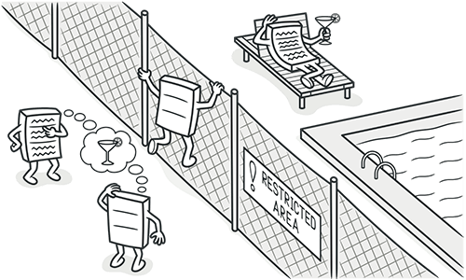
Why MoveMethod Matters
Top-5 most common refactoring
Improves cohesion, reduces coupling
Reduces Technical Debt and removes code smells: God Class, Feature Envy, Duplicate Code
Notes:
Move Method refactoring is among the top-5 refactorings in practice. This refactoring takes a misplaced method that interacts more with another class state than its own class and moves it to the correct class.
It improves cohesion, reduces coupling, and removes smells like God Class or Feature Envy.
=========
Misplaced methods, that is methods that interact more with another class state than its own, are a major contributor to Technical Debt and code smells.
CLICK> They are responsible for very large, bloated classes, sometimes called God Classes, that have too many responsibilities.
CLICK> They also result in Feature Envy, where a method craves access to the state variables of another class, instead of operating with state variables and fields from its own class.

Slide 3
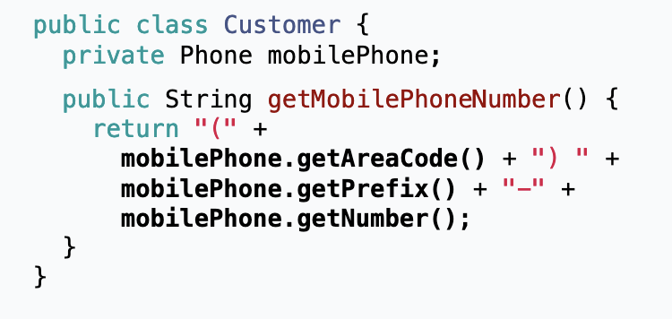
MoveMethod Refactoring to the Rescue
Move to Phone class
Notes:
TODO: add some animation/screenshot showing that we split getMobilePhone Number into class Phone, and update the call site from Customer to call mobilePhone.getMobilePhoneNumber
Automating this saves developers significant effort in maintaining software quality.

Slide 4
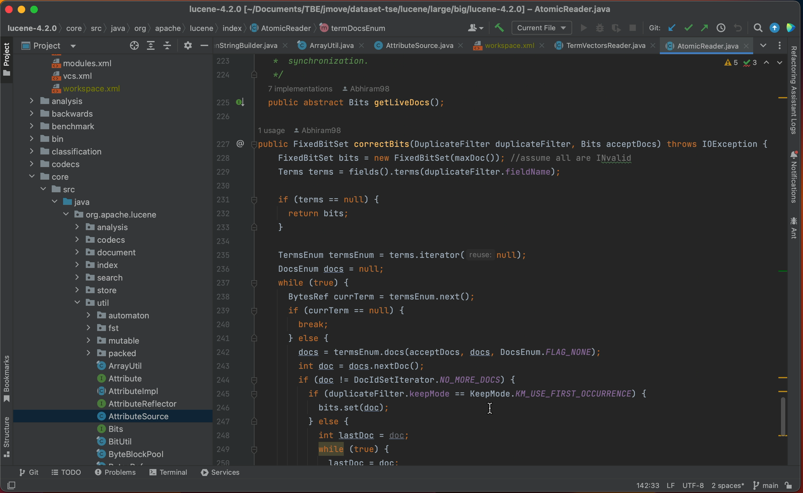


Current Move Method Workflow in IntelliJ
JetBrains’ IntelliJ IDEA has Move Method capabilities
Semi-automated process
No automatic recommendations
Notes:
Modern IDEs, such as JetBrains’ IntelliJ IDEA, automate several parts of the Move Method refactoring lifecycle. However, this is a semi-automated process, in which the developer has to manually determine which method is out of place, and which target class is a better suitable home for such misplaced method.

Slide 5

Approaches for MM Recommendations
Static analysis (JMove, JDeodorant)
- thresholds, slow (hours), poor scalability
ML (RMove, PathMove) / DL (FeTruth, Hmove)
- need retraining, overwhelm users
?
Optimize software quality metrics
Do not align with how developers refactor code
LLMs
- prolific, capture semantic intuition
Notes:
Static analysis tools (e.g., JMOVE): rely on thresholds, don’t scale, take hours.
ML/DL tools (e.g., FETRUTH, HMOVE): require retraining, treat it as classification, overwhelm devs with dozens of noisy recs.
CLICK: because these approaches all work based on optimizing software quality metrics, they tend to generate recomemndations that do not align with how developers refactor code.
We hypothesize that achieving good software design that is easy to understand and resilient to future changes is a balancing act between science (e.g., metrics, design principles)and art (e.g., experience, expertise, and intuition about what constitute good abstractions).
LLMs: new hope — capture semantic misfits and developer intuition. We hypothesize that, due to their extensive pre-training on billions of methods and their reliance on the naturalness of code, LLMs can generate an abundance of MOVEMETHOD recommendations. We also expect LLM recommendations to better align with expert practices

Slide 6
Key Challenges
LLM Hallucinations - 80% invalid recommendations
Context window limits – can’t reason over large projects
Workflow fit – needs to be fast and IDE-integrated
Notes:
Hallucinations — invalid or impossible recs dominate. Up to 80% of recommendations are invalid.
Context window — MOVEMETHOD refactoring requires global, project-level reasoning to determine the best target classes where to relocate a misplaced method. However, passing an entire project in the prompt is beyond the limited context window of current LLMs. So we can’t feed entire project, even if we could, this would not help as LLMs lose focus.
Workflow fit — tools must be fast, lightweight, and IDE-integrated.
These challenges block adoption of LLMs for practical refactoring.

Slide 7

Our Insights
Combine LLM creativity + IDE rigor
Filter hallucination via static preconditions checks in IDE
Semantic embeddings + Refactoring-aware RAG
Few high-quality recommendations (≤3 per class)
Notes:
Combine LLM creativity with IDE rigor: science + art.
We discovered novel ways to automatically eliminate LLM hallucinations, by complementing LLM reasoning (i.e., the creative, non-deterministic, and
artistic part akin to human naturalness) with static analysis embedded in the IDE (i.e., the rigorous, deterministic, scientific part).
Use semantic embeddings + refactoring-aware RAG to narrow context of the search space.
For a practical user experience, we present devs with just a few high-quality, actionable suggestions (≤3/class) that are guaranteed to execute correctly with the IDE.
We implemented these ideas MM-ASSIST is an IntelliJ plugin that automates the entire Move Method lifecycle.

Slide 8
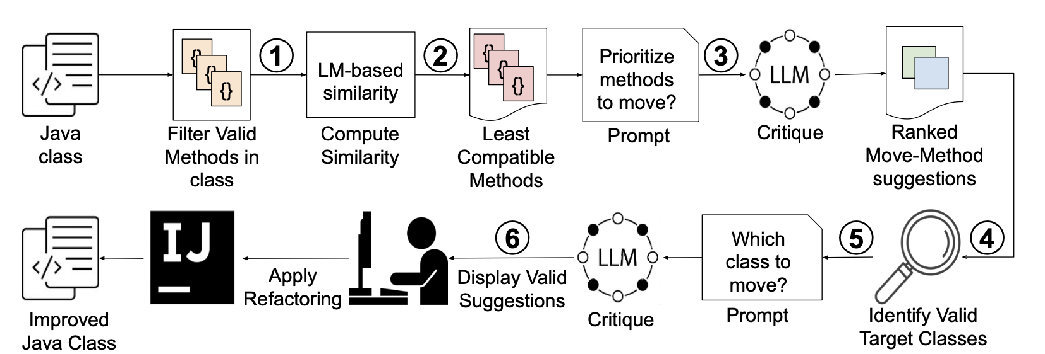
MM-Assist: Workflow
Notes:
Pipeline: preconditions → embeddings → LLM critique & ranking → semantic RAG → IDE executes safely.
Key: synergistically combines LLM, IDE, embeddings, and static analysis.
Developers stay in control, approving only what they trust.

Slide 9
Empirical Evaluation Setup
Two Datasets:
Synthetic corpus of 235 MM scenarios
New real-world corpus 210 MM (2024+, OSS), avoids LLM training contamination
Formative study
Baselines: JMove, FeTruth, HMove, Vanilla LLM
User study: 30 participants, 1 week, own project
Notes:
Two datasets:
Synthetic corpus (widely used in prior work).
New real-world corpus: 210 actual refactorings mined from 2024+ OSS commits — avoids LLM training contamination.
Compared against JMOVE, FETRUTH, HMOVE, and vanilla LLMs.
Plus: user study — 30 developers used MM-ASSIST on their own projects for a week.
======
RQ1: How effective are LLMs at suggesting opportunities for MM refactoring?
RQ2: How effective is MM-ASSIST at suggesting opportunities for MM refactoring?
RQ3: What is MM-ASSIST’s runtime performance?
RQ4: How useful is our approach for developers

Slide 10
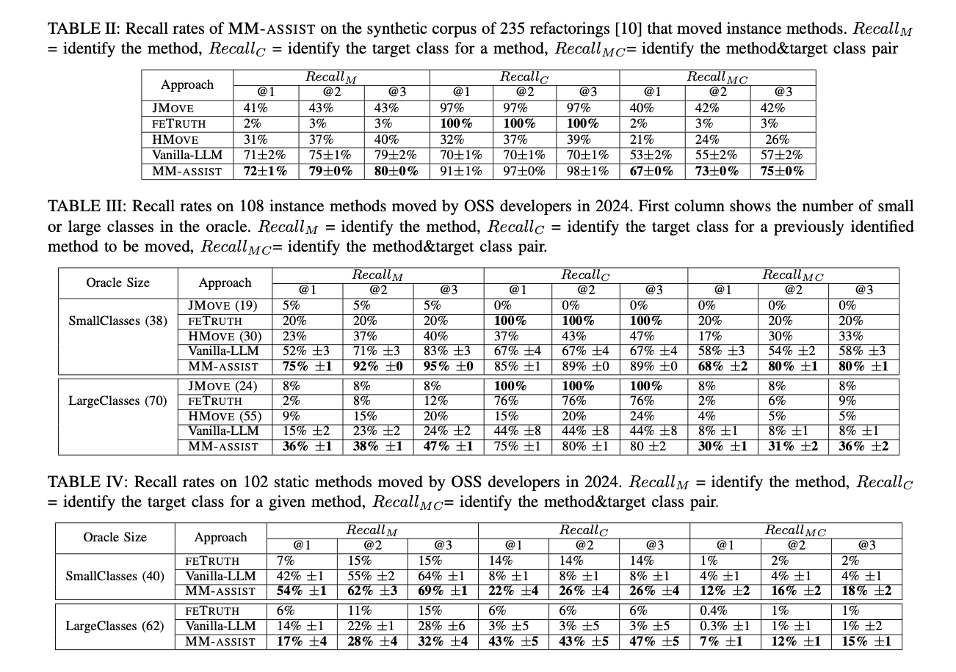
Results: Synthetic Corpus
235 MM scenarios
Metric: Recall@K for top-K recommendations
MM-ASSIST Recall@1 = 67%, Recall@3 = 75%
Baselines: JMOVE ~40%, HMOVE ~26%, FETRUTH only 2–3%
1.7x improvement over best baseline
LLM alone performed better than old tools but still plagued by hallucinations
Notes:
MM-ASSIST Recall@1 = 67%, Recall@3 = 75%.
Baselines: JMOVE ~40%, HMOVE ~26%, FETRUTH only 2–3%.
1.7x improvement over best baseline.
LLM alone performed better than old tools but still plagued by hallucinations

Slide 11
Results: Real-World Corpus + User study
Replicated 210 OSS refactorings (uncontaminated by LLM training)
MM-ASSIST Recall@3 = 80% vs 33% (baselines) → 2.4x improvement.
Runtime: ~30 seconds vs hours or days for baselines.
User study: 30 devs, 350 classes analyzed → 83% positive ratings, avg. 7 accepted refactorings/user.
Dev quote: “Skeptical about AI, but glad to delegate grunt work.”
Notes:
On 210 OSS refactorings: MM-ASSIST Recall@3 = 80% vs 33% (HMOVE). → 2.4x improvement.
Runtime: ~30 seconds vs hours/days for baselines.
User study: 30 devs, 350 classes analyzed → 82.8% positive ratings, avg. 7 accepted refactorings/user.
Dev quote: “Skeptical about AI, but glad to delegate grunt work.”
===============
30 students (25 Master’s and 5 Ph.D. students)
73% have industrial experience.
30 participants applied MM-ASSIST on 350 classes. MM-ASSIST analyzed 1,143 classes
Positive Rating 82.8% of the time
applied a total of 216 refactoring recommendations on their code

Slide 12
Executive Summary
First end-to-end LLM-powered Move Method assistant
Key Idea: LLMs (creative)+ IDEs (validation) + Refactoring-Aware RAG (lookup)
- addresses hallucinations + context limits via IDE + RAG
2–4× better recall, 10–100× faster
Trusted by developers (83% positive)
Techniques generalize to other refactorings
Notes:
TODO: QR code for paper, screenshot of the webpage/datasets>
MM-ASSIST: first end-to-end LLM-powered Move Method assistant.
Tackles hallucinations + context limits via IDE validation + semantic RAG.
Outperforms SOTA: 2–4x better recall, 10–100x faster.
Developers trust and adopt it.
Broader impact: techniques generalize to other refactorings (Extract Class, Split Package).
Together, LLMs + IDE + semantic analysis are stronger than any alone.

Slide 13
Bonus Slides

Slide 14
Move Method Refactoring in IntelliJ
Notes:
TODO: consider replacing this with the example shown in the previous slide with Phone/ MobilePhone number
Here is how it works in practice. First, you identify a method which is misplaced. Second you identify a suitable target class, and trigger the refactoring within the IDE.

Slide 15
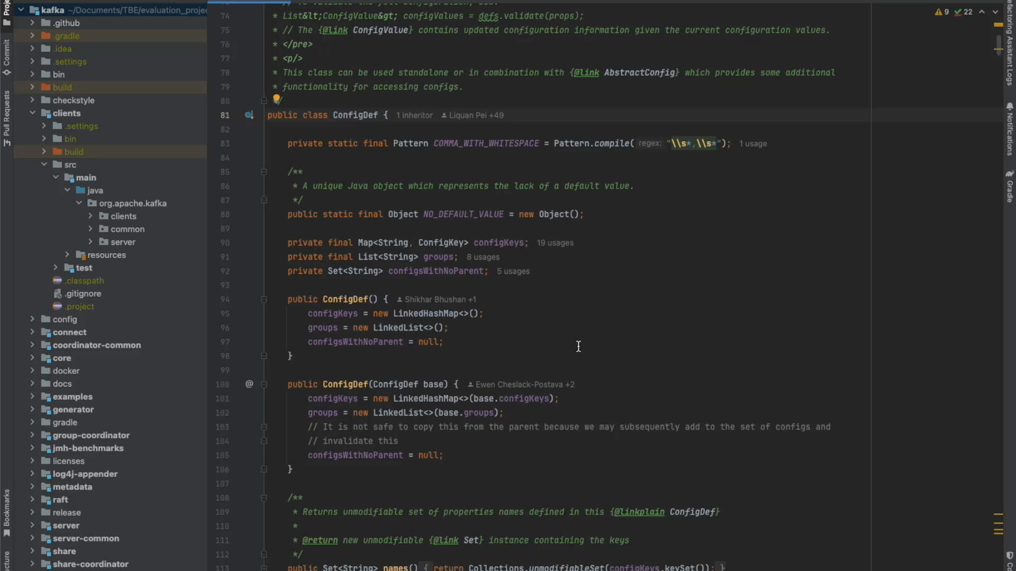
Demo MM-Assist

Slide 16
Lessons Learned
LLM Critique –
Can be too harsh
High hallucination rate 80%
Task Decomposition helped – instead of depending on LLM to do everything
Data leakage problem

Slide 17
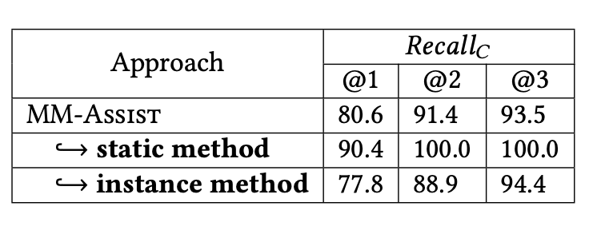
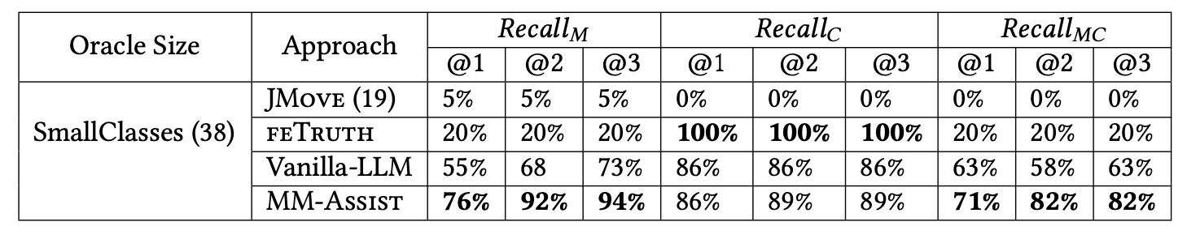
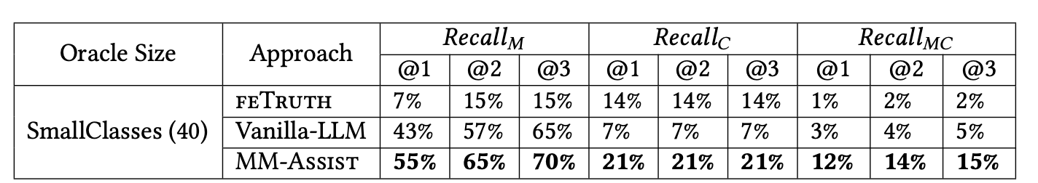
LLM Data Leakage
Gpt-4o training data cutoff: Oct-2023
MM in 2015.
Instance MM in 2024
Static MM in 2024

Slide 18
Your Questions: Core Methodology and RAG Pipeline
Regarding the core methodology, can semantic retrieval meaningfully identify better refactoring targets than traditional dependency graph analysis?
What are the specifics of the RAG pipeline—including the choice of VoyageAI models, the number of retrieved classes, and the prompt optimization strategy, and does using partial class summaries for retrieval significantly degrade recommendation quality?
How effective is cosine similarity for code, and what is the justification for weighting package proximity 2x higher than the utility metric in the RankingScore formula?

Slide 19
Tool Design, Usability, and Edge Cases
From a usability standpoint, how does the tool handle edge cases like finding no suitable candidates (does it fail gracefully or hallucinate?)
What is the workflow for complex "God Classes"?
What was the rationale for limiting suggestions to three candidates, and does this hinder the full exploration of refactoring options without repeated use?

Slide 20
Evaluation, Performance, and Generalizability
In terms of the evaluation, are the reported performance gains primarily due to the novel algorithm, or could they be attributed to failures or limitations in the baseline tools used for comparison?
What were the main reasons developers rejected 17.2% of suggestions?
How does the tool's performance scale to massive codebases?
How would it translate to dynamic languages like Python?
What is the expected gain from using a domain-tuned embedding model?

Slide 21
Cost, Practicality, and Real-World Adoption
Considering practical adoption, what is the tool's financial viability, and how would its performance and cost change if using an open-source LLM instead of a commercial API?
What are the long-term integration complexities and developer privacy concerns?
Crucially, what are the potential implications of the LLM introducing "design hallucinations," especially when applying such a tool to safety-critical codebases?

Slide 22
Future Work and Potential Improvements
For future work, beyond improving method-level suggestions by integrating static metrics or creating a personalized memory system, can this architecture be extended to support more complex tasks?
For instance, could it facilitate large-scale architectural refactorings or even serve as a tool for collaborative design sessions among multiple developers?

Slide 23
Research and Development Process
Could you share insights into the development process itself? Was the plugin built from scratch or did it reuse components from EM-assist?
And how did you manage the balance between development and user testing under a tight conference deadline?

Slide 24
Workflow

Slide 25
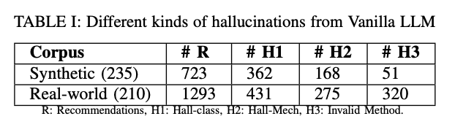
RQ1: How effective are LLMs at suggesting opportunities for MM refactoring?
80% of LLM’s suggestions are hallucinations

